Slide 1

Laboratory for
Data Technologies

Slide 2

Motivation
Telecom Operators
SME
Asset & Time mgmt
Smart House/
Building/
City
Smart Energy/Grid
Smart Traffic/
Lights/
Transport
eTolling
eHealth
Industry specific adoption layer
RR1 – Intelligent Infrastructure
RR2 - Services and Things management
OccapiTM
RR3 – Open Intelligent Communication Platform

Slide 3
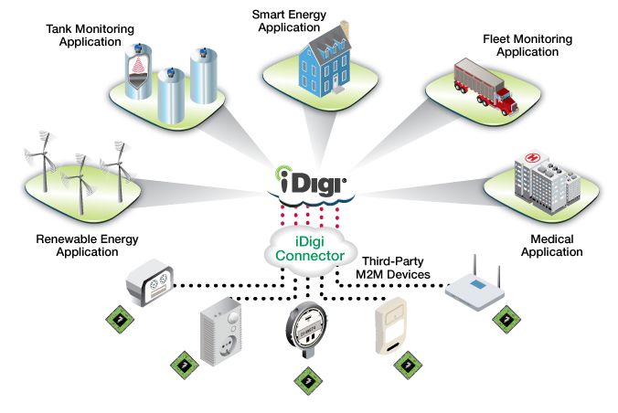
IoT Platforms
BigData
Real Time Processing
CEP
Prediction
Open connectors
BAM, Dashboards

Slide 4
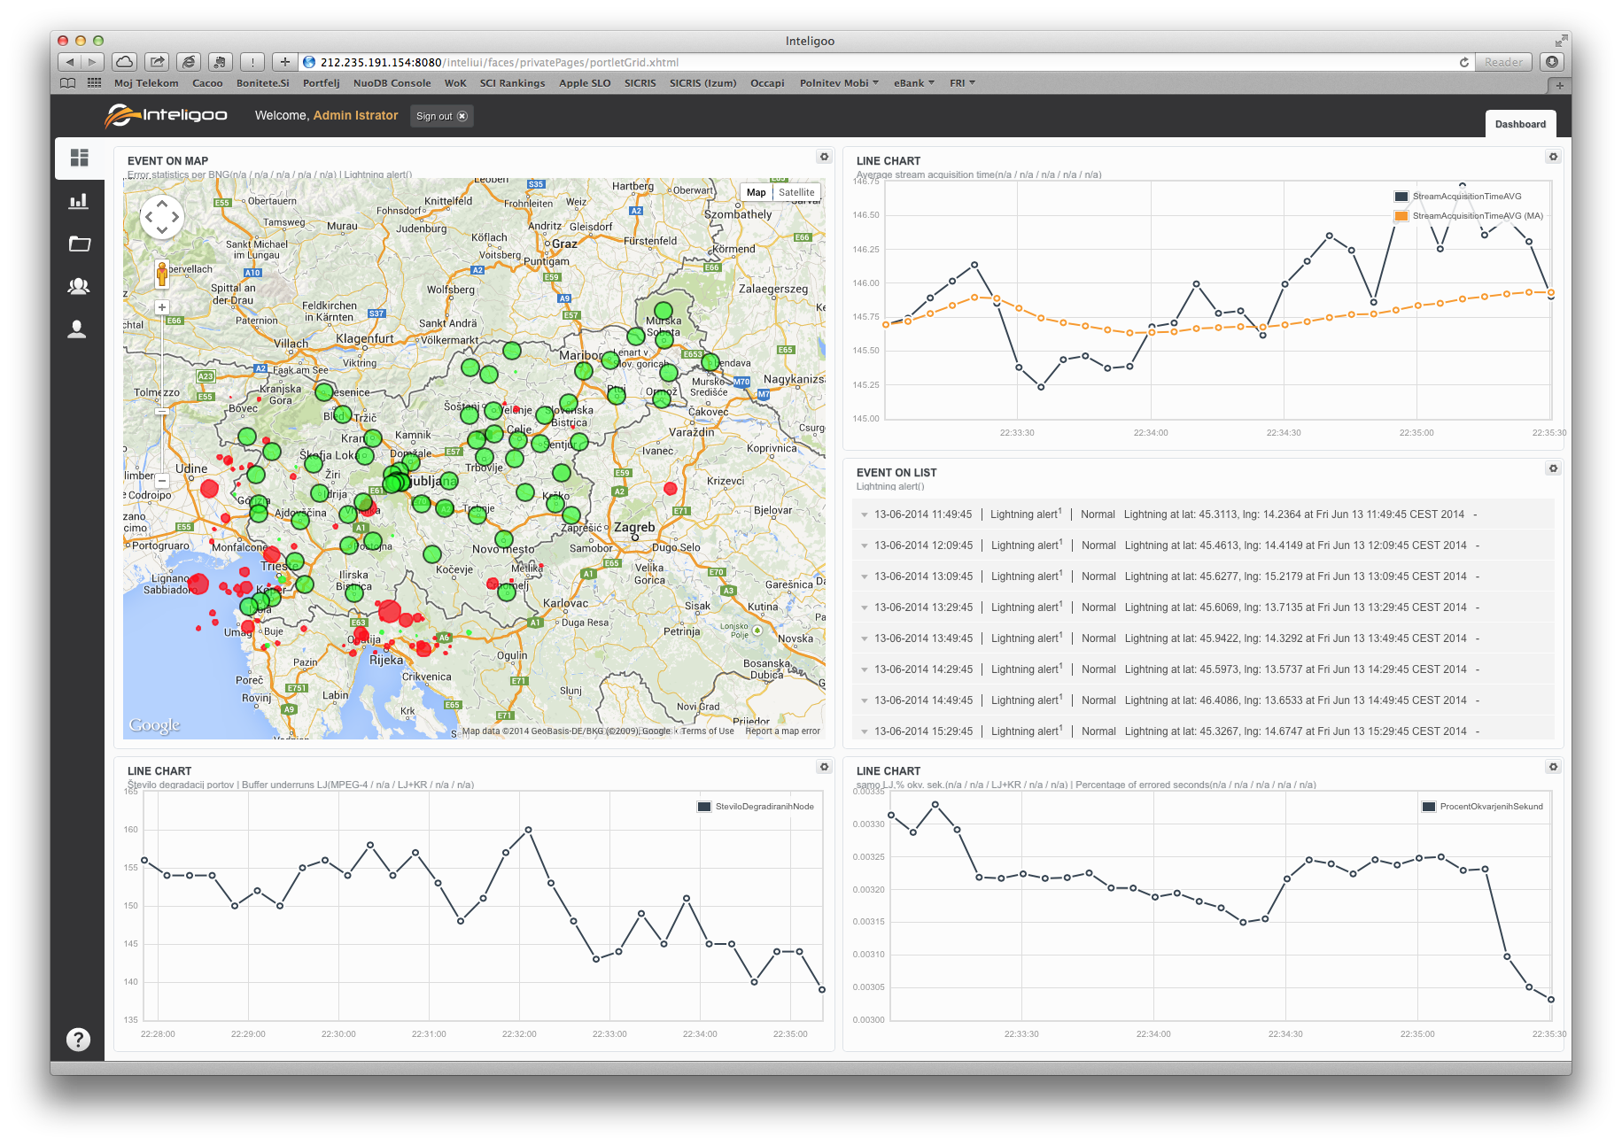

Slide 5
Past
Real time
Future
0.010%
0.008%
0.006%
0.004%
0.002%
0.000%
00 01 02 03 04 05 06 07 08 09 10 11 12 13 14 15 16

Slide 6

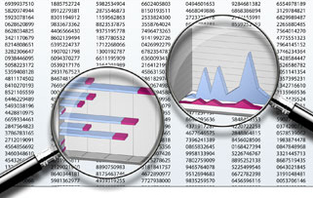
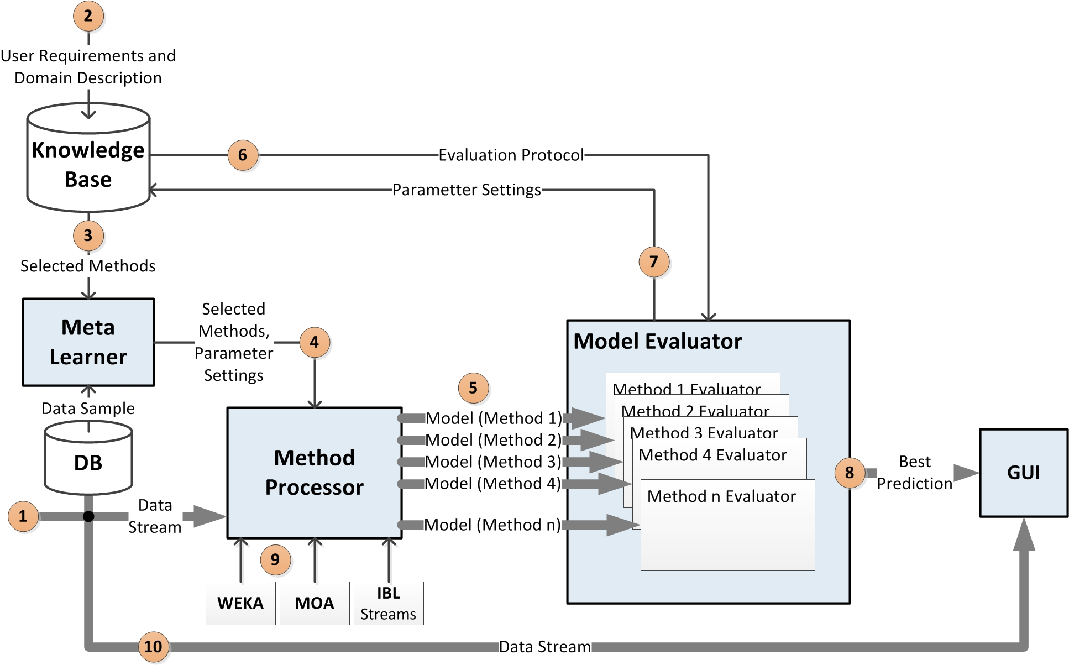
Objective
To capture expert knowledge
To computerize the stream mining process

Slide 7
Approach
Observe experts at work;
Identify the main activities in the stream mining process – focus on the activities where the experts’ knowledge is crucial;
Acquire expert knowledge;
Prototype an expert system;
Evaluate on different datasets;

Slide 8
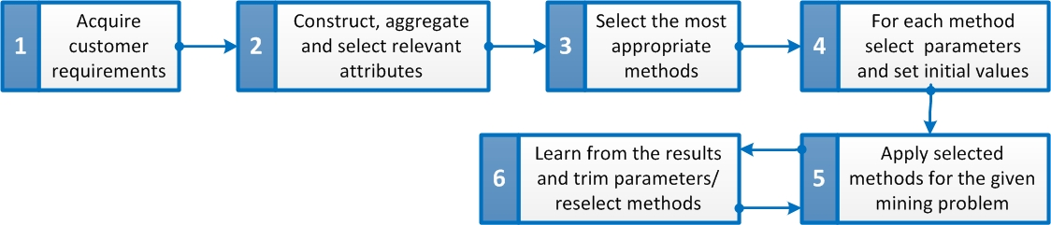
Process

Slide 9
Prototype

Slide 10
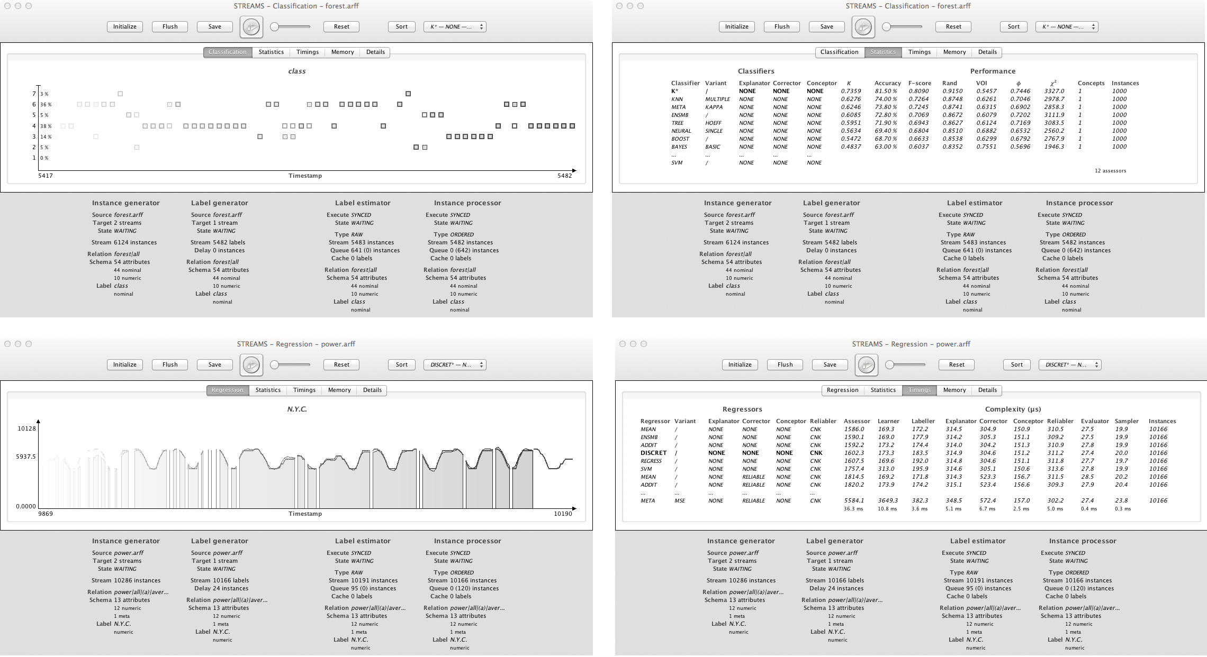
Prototype

Slide 11

Evaluation
Experimental framework:
  Standard statistics (classification: CA, Kappa, F, Rand index; regression: MAE, MAPE, RMSE, Pearson);
  Performance comparison: Q-statistics
Datasets:
  Flight delay prediction (USA, 1987-2008);
  Electricity market price (New South Wales, Australia)
  Electric energy consumption (Portugal);
  Solar energy forecast (USA, Oclahoma)

Slide 12
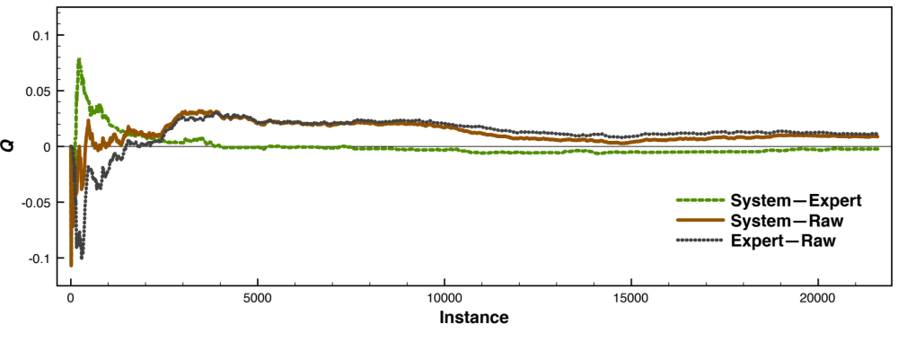
Flight delay prediction

Slide 13
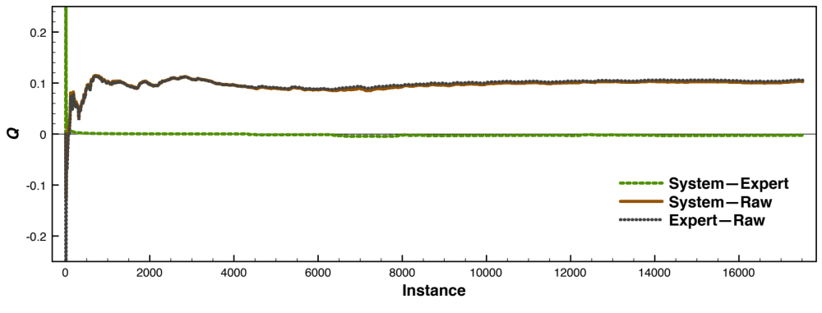
Electricity marketplace

Slide 14
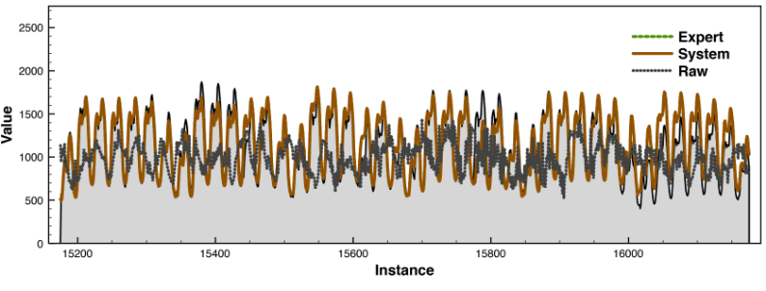
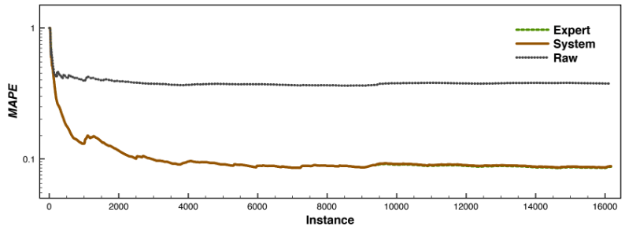
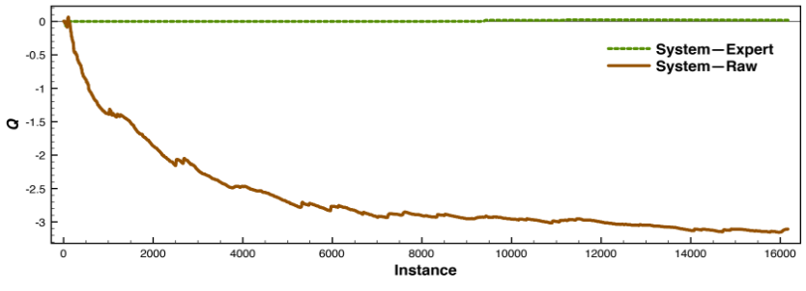
Electric energy consumption

Slide 15
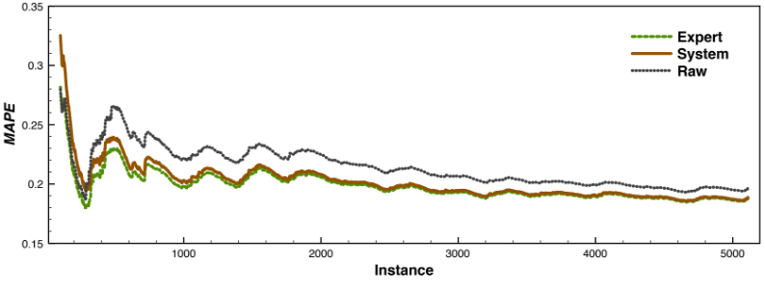
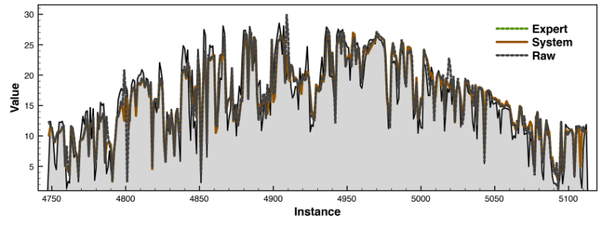
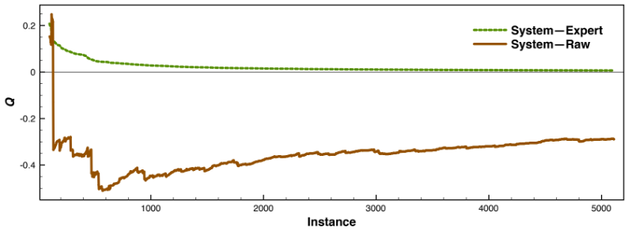
Solar energy forecast

Slide 16
Conclusions
For stream mining expert knowledge is required;
The expert knowledge is sufficiently routinized and can be captured as explicit knowledge and computerized;
Important finding for the development of IS on the field of big data, IoT and similar.
Further work:
  Full deployment of the meta learner (different learning techniques possible);
  Evaluation on more datasets;
  Testing in real settings (time complexity, required resources, problem scalability…);

